Slide 1
Marketing Attribution
Data analysis with SQL
Ekaterina Chernyakova
22/05/2020

Slide 2
Table of Contents
CoolTShirts is an innovative apparel shop running a bunch of marketing campaigns. In this project, I’ll be helping them answer these questions about their campaigns:
1. Getting familiar with the company
1.1 How many campaigns and sources does CoolTShirts use and how are they related?
1.2 What pages are on their website?
2. Defining the user journey
2.1 How many first touches is each campaign responsible for?
2.2 How many last touches is each campaign responsible for?
2.3 How many last touches on the purchase page is each campaign responsible for?
3. Optimising the campaign budget

Slide 3
1.Getting familiar with the company

Slide 4
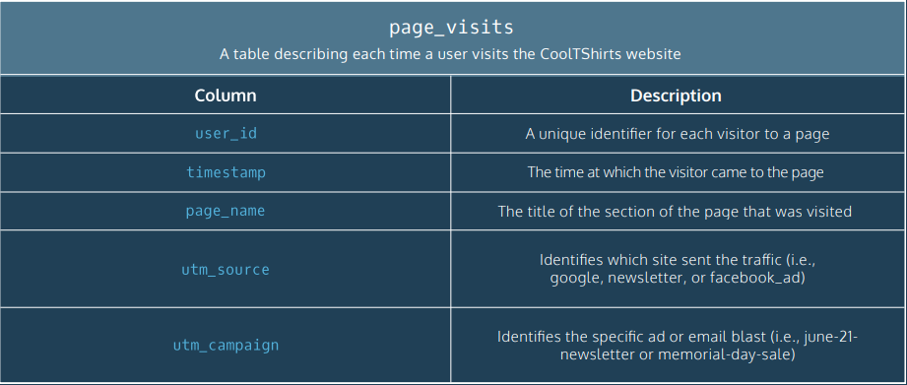

Slide 5
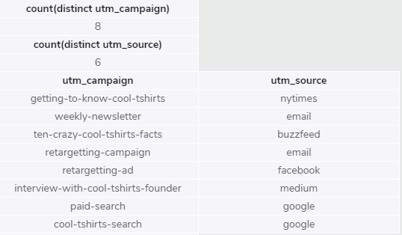
1.1 Getting familiar with the company
CoolTShirts uses 8 campaigns and 6 sources
From the table below we can see which source is used for each campaign.
select count(distinct utm_campaign)
from page_visits;
select count(distinct utm_source)
from page_visits;
select distinct utm_campaign, utm_source
from page_visits;

Slide 6
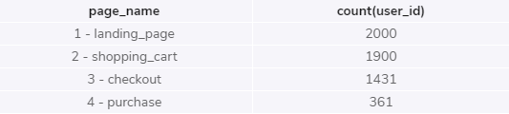
1.2 What pages are on CoolTShirts website?
CoolTShirts has 4 pages on their website: landing page, shopping_cart, checkout, purchase
The conversion rate of CoolTShirts website is 18%
SELECT page_name, count(user_id)
from page_visits
group by 1;

Slide 7
2. Defining the user journey

Slide 8
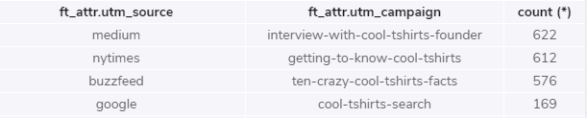
2.1 How many first touches each campaign is responsible for
From the table below we can see that :
Medium utm_source with the interview-with-cool-tshirts-founder campaign attracted the most of the users: 622 out of a total of 2000.
Nytimes utm_source with the getting-to-know-cool-tshirts campaign attracted almost the same amount of users as the previous campaign, 612 out of a total of 2000
WITH first_touch AS (
SELECT user_id,
MIN(timestamp) as first_touch_at
FROM page_visits
GROUP BY user_id),
ft_attr AS (
SELECT ft.user_id,
ft.first_touch_at,
pv.utm_source,
pv.utm_campaign
FROM first_touch as ft
JOIN page_visits as pv
ON ft.user_id = pv.user_id
AND ft.first_touch_at = pv.timestamp)
select ft_attr.utm_source,
ft_attr.utm_campaign,
count (*)
from ft_attr
group by 1, 2
order by 3 desc;

Slide 9
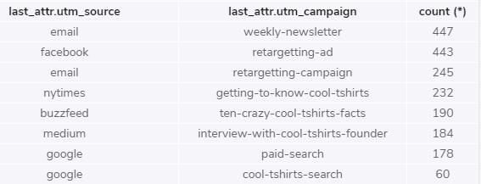
2.2 How many last touches is each campaign responsible for?
From the table below we can see that :
Most of the last users interactions were with weekly-newsletter campaign on email utm_source
The second biggest amount of users had their last touch on facebook utm_source with retargeting-ad campaign
It is important to know how many last touches each campaign is responsible for,
but it is more important to know how many last interactions were exactly on the purchase page of each campaign.
WITH last_touch AS (
SELECT user_id,
MAX(timestamp) as last_touch_at
FROM page_visits
GROUP BY user_id),
last_attr AS (
SELECT lt.user_id,
lt.last_touch_at,
pv.utm_source,
pv.utm_campaign
FROM last_touch as lt
JOIN page_visits as pv
ON lt.user_id = pv.user_id
AND lt.last_touch_at = pv.timestamp)
select last_attr.utm_source,
last_attr.utm_campaign,
count (*)
from last_attr
group by 2
order by 3 desc;

Slide 10
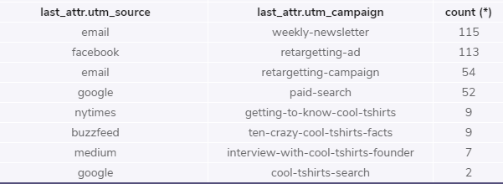
2.3 How many last touches on the purchase page is each campaign responsible for?
From the table below we can see that :
Most of the last user interactions on the purchase page were with the weekly-newsletter campaign on email utm_source
The second biggest amount of users had their last touch on the purchase page on utm_source facebook with the retargeting-ad campaign
WITH last_touch AS (
SELECT user_id,
MAX(timestamp) as last_touch_at
FROM page_visits
GROUP BY user_id),
last_attr AS (
SELECT lt.user_id,
lt.last_touch_at,
pv.utm_source,
pv.utm_campaign
FROM last_touch as lt
JOIN page_visits as pv
ON lt.user_id = pv.user_id
AND lt.last_touch_at = pv.timestamp)
select last_attr.utm_source,
last_attr.utm_campaign,
count (*)
from last_attr
group by 2
order by 3 desc;

Slide 11
3. Optimising the campaign budget
CoolTShirts wants to re-invest in 5 campaigns to keep diversified marketing channels. Based only on given factors I would recommend choosing the interview-with-cool-tshirts-founder campaign since this particular campaign attracted the biggest amount of users to visit CoolTShirts (622).
I would also recommend the following four campaigns as these brought the biggest amount of users to the purchase page:
weekly-newsletter
retargeting-ad
retargeting-campaign
paid-search
Two of these campaigns focus on retargeting which go hand in hand with the other campaigns.
last_attr.utm_source | last_attr.utm_campaign | Count
email | weekly-newsletter | 115
facebook | retargeting-ad | 113
email | retargeting-campaign | 54
google | paid-search | 52

